Slide 1
Demand Analysis
The Law of Demand
Management 405
Prof. Clemence Tricaud · UCLA Anderson

Slide 2
Demand Analysis · Course Roadmap
Agenda for the Class
1. Basic Principles and Economic Way of Thinking
2. Value and Demand
3. Supply and Cost
we are here
4. Markets, Pricing, and Strategy
Management 405 · Demand Analysis
3

Slide 3
Demand Analysis · Outline
Outline
1
The Law of Demand
When price falls, quantity demanded rises — holding all else constant
2
Elasticities
How responsive demand is to own price, income, and competitors' prices
3
Demand and Revenue
How own-price elasticity drives total revenue, and how to find marginal revenue
4
Demand Estimation
Measuring demand through market experiments and regression analysis
Management 405 · Demand Analysis
4

Slide 4
Demand Analysis · The Law of Demand
Outline
1
The Law of Demand
When price falls, quantity demanded rises — holding all else constant
2
Elasticities
How responsive demand is to own price, income, and competitors' prices
3
Demand and Revenue
How own-price elasticity drives total revenue, and how to find marginal revenue
4
Demand Estimation
Measuring demand through market experiments and regression analysis
Management 405 · Demand Analysis
5

Slide 5
Demand Analysis · The Law of Demand
The Law of Demand
The demand curve is downward sloping
As the price of a good falls, the quantity demanded rises — all else constant
Price
As the price declines:
1. More customers are willing to buy the product
2. Existing customers buy more
D
Quantity
Management 405 · Demand Analysis
6

Slide 6
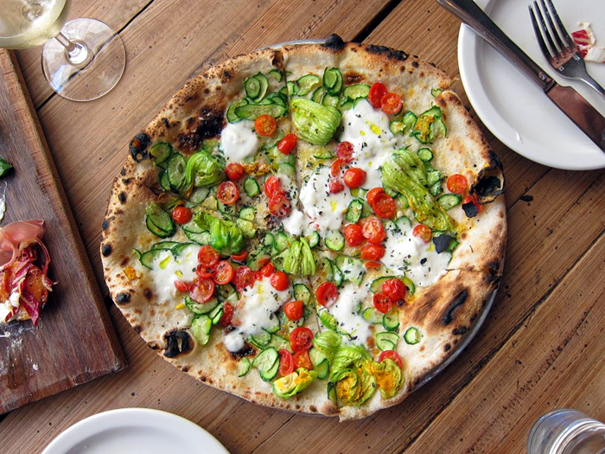
Demand Analysis · The Law of Demand
1. More Customers Buy the Product
How much would you pay for a slice of Gjelina pizza when you're hungry?
Your maximum willingness to pay is your Marginal Personal Value (MPV) of the slice
Poll break
Management 405 · Demand Analysis
7

Slide 7
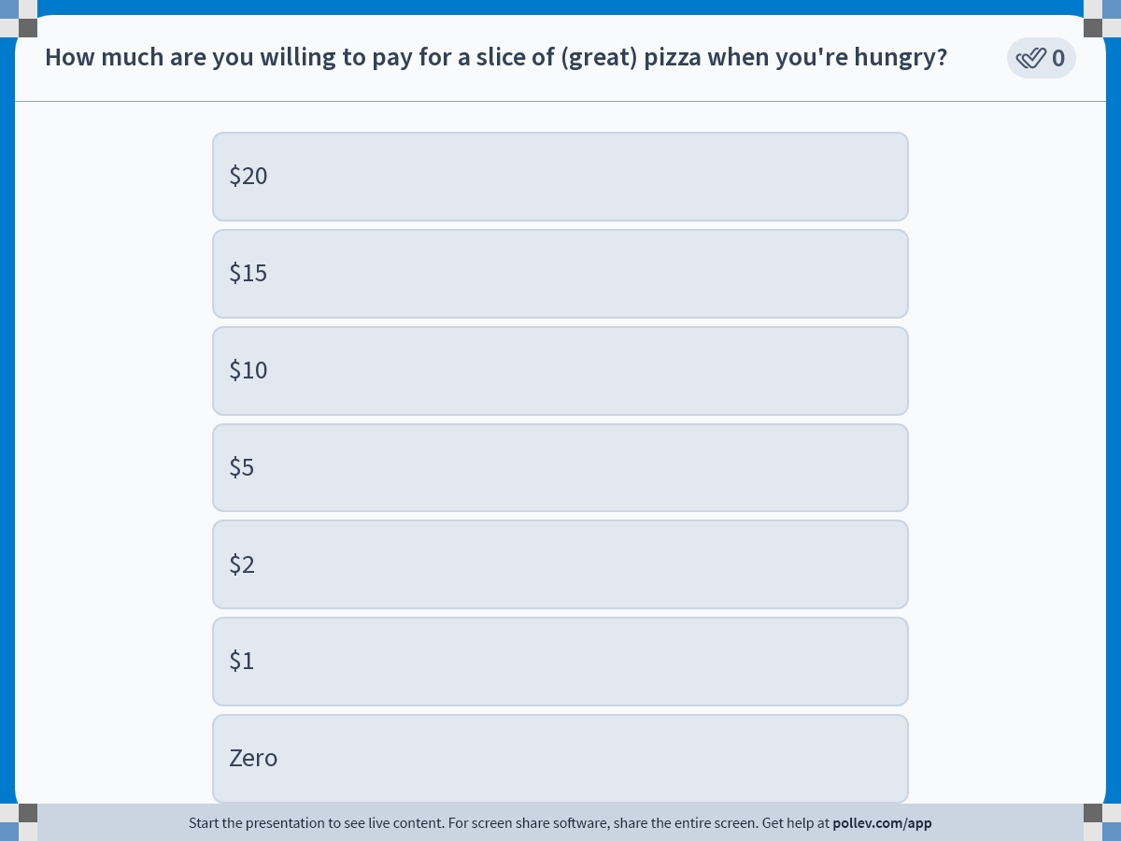
Demand Analysis · The Law of Demand
Poll: What Would You Pay?
Management 405 · Demand Analysis
8

Slide 8
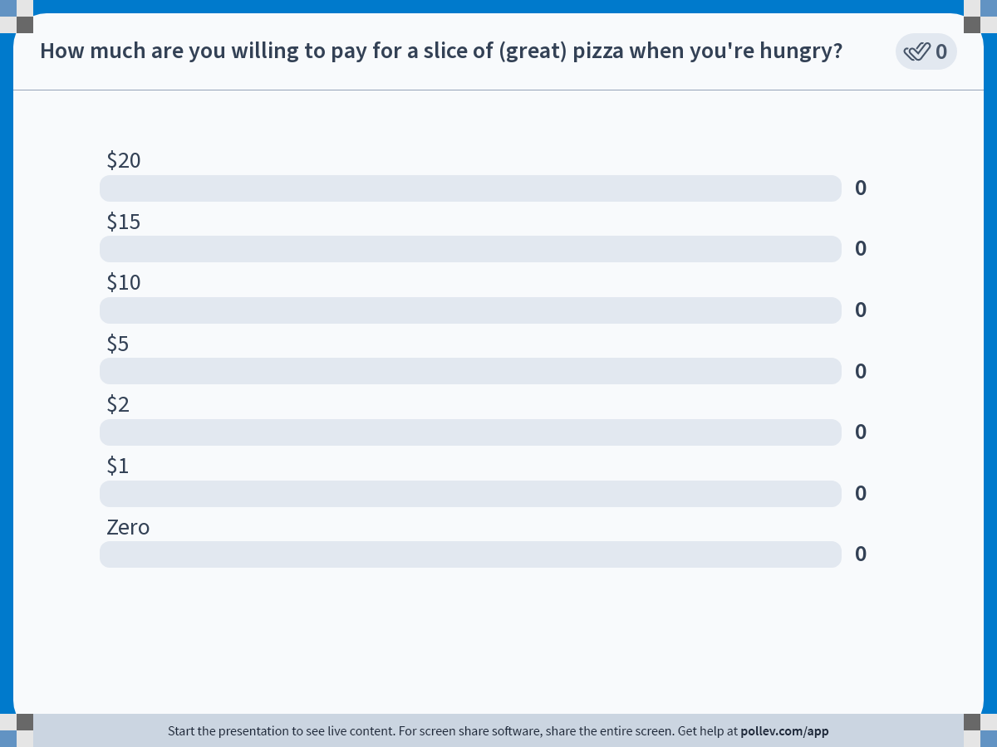
Demand Analysis · The Law of Demand
Poll Results
Management 405 · Demand Analysis
9

Slide 9
Demand Analysis · The Law of Demand
1. More Customers Buy the Product
Management 405 · Demand Analysis
10

Slide 10
Demand Analysis · The Law of Demand
The Law of Demand
The demand curve is downward sloping
As the price of a good falls, the quantity demanded rises — all else constant
Price
As the price declines:
1. More customers are willing to buy the product
2. Existing customers buy more
D
Quantity
Management 405 · Demand Analysis
11

Slide 11
Demand Analysis · The Law of Demand
2. Existing Customers Buy More
How much for a slice of Gjelina pizza when you're hungry?
What about a second slice?
A third?
A fourth?
A millionth?
… Diminishing Marginal Personal Value (MPV)!
Management 405 · Demand Analysis
12

Slide 12
Demand Analysis · The Law of Demand
Each Extra Slice Is Worth Less
Price ($)
p1
20
p2
15
MPV for
1st slice
p3
10
MPV for
2nd slice
MPV for
3rd slice
p4
5
MPV for
4th slice
MPV for
5th slice = 0
0
1
2
3
4
5
Quantity (slices)
Marginal Personal Value falls with each additional unit
Management 405 · Demand Analysis
13

Slide 13

Demand Analysis · The Law of Demand
Diminishing Marginal Personal Value
“
I can understand wanting to have a million dollars… but once you get beyond that, I have to tell you, it’s the same hamburger.
— Bill Gates
Management 405 · Demand Analysis
14

Slide 14
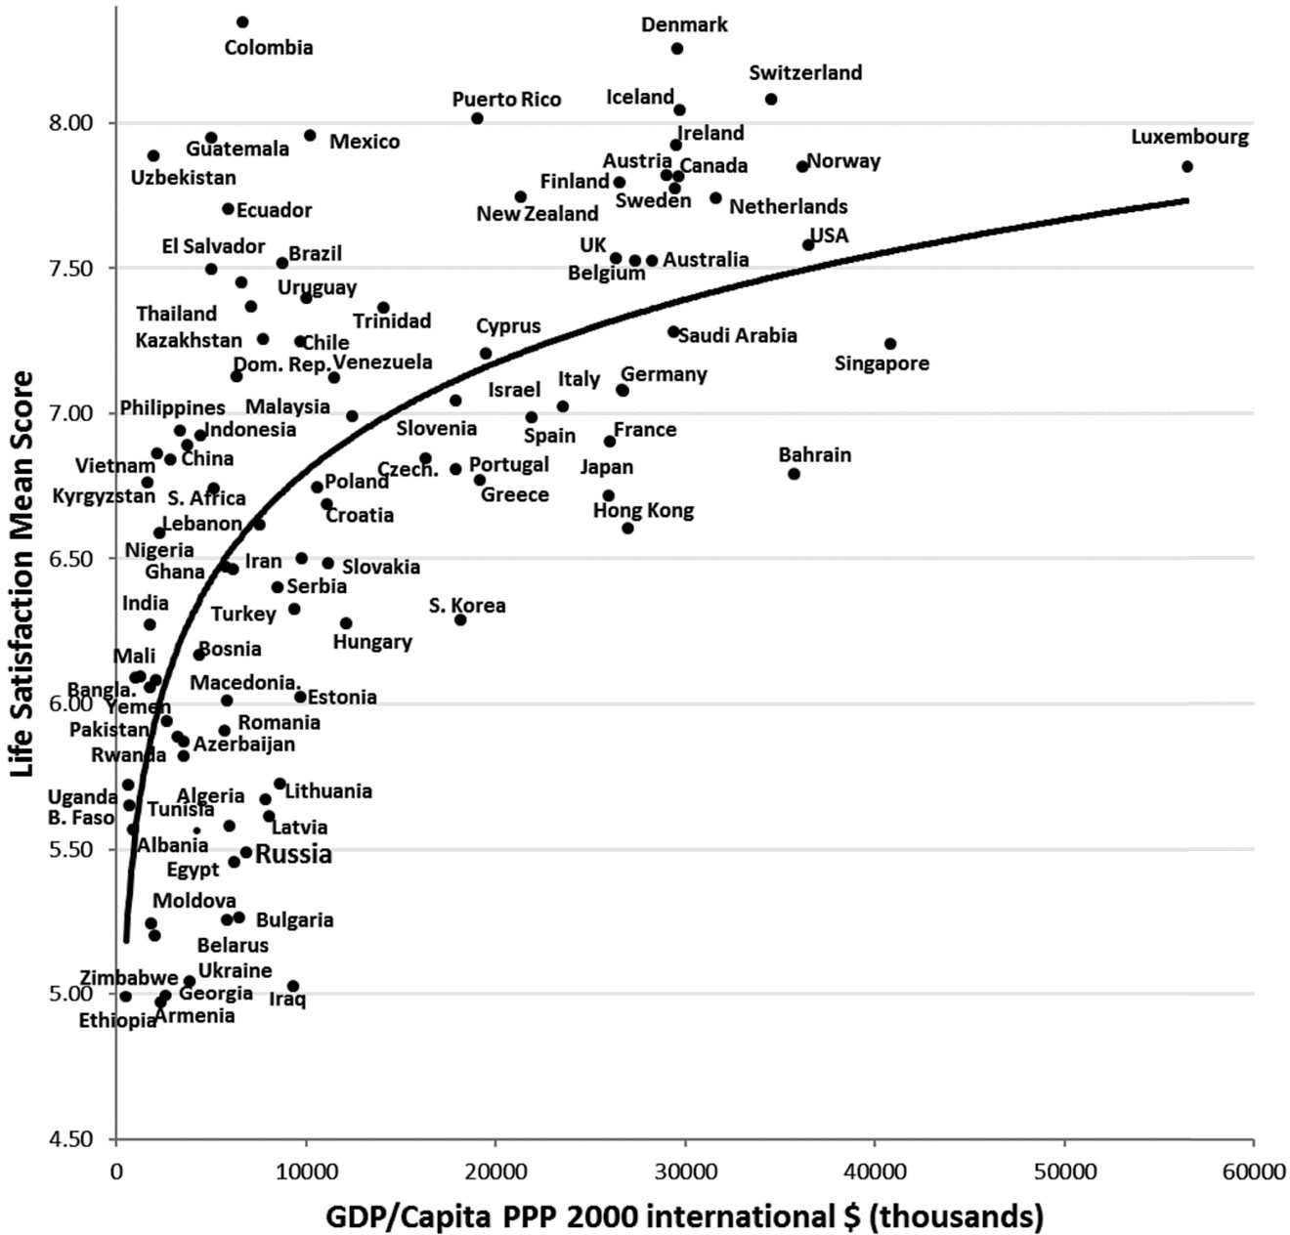
Demand Analysis · The Law of Demand
Diminishing Marginal Personal Value
Life satisfaction vs. income across countries
Source: Inglehart (2018)
Management 405 · Demand Analysis
15

Slide 15
Demand Analysis · The Law of Demand
Consumers Optimize Where MPV = MC
Optimization rule (from class 1)
MB = MC
Marginal benefit (MB) = Marginal Personal Value (MPV)
Marginal cost (MC) = price of the good + opportunity cost (e.g., time)
Choose Q where MPV = MC · if MPV > MC buy more · if MPV < MC buy less
Management 405 · Demand Analysis
16

Slide 16
Demand Analysis · The Law of Demand
The Optimal Quantity Sets MPV = MC
$/movie
MPV diminishes as more and more
movies have been watched
MPV is the demand curve
(strictly, the “inverse” demand curve)
MC (incl. opportunity cost)
Q*
Movies per week
Management 405 · Demand Analysis
17

Slide 17
Demand Analysis · The Law of Demand
Market Demand Sums Individual Demands
Price ($)
Consumer 1
+
Consumer 2
=
Market demand
+
=
p1
+
=
p2
+
=
p3
+
=
p4
1
2
3
4
5
6
7
8
9
10
11
12
Quantity
Management 405 · Demand Analysis
18

Slide 18
Demand Analysis · The Law of Demand
What Shifts the Demand Curve? Factors Affecting Demand
Income
Prices of related goods
Complements versus substitutes
Price expectations
Population size and composition
Network effects
Snob and bandwagon effects
Price
demand
rises
demand
falls
D
Quantity
Management 405 · Demand Analysis
19

Slide 19


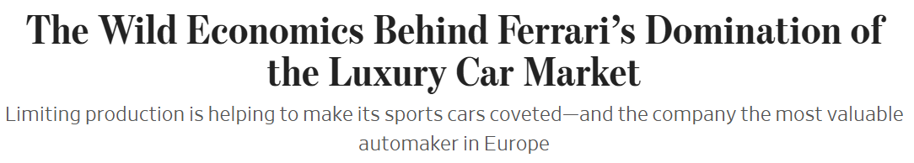
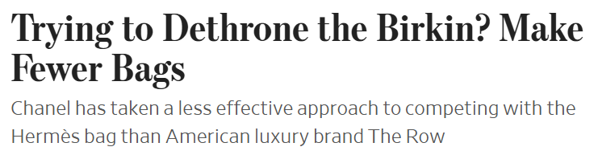
Demand Analysis · The Law of Demand
The Snob Effect in the News
Management 405 · Demand Analysis
20

Slide 20
Demand Analysis · The Law of Demand
What Shifts the Demand Curve? Factors Affecting Demand
Income
Prices of related goods
Complements versus substitutes
Price expectations
Population size and composition
Network effects
Snob and bandwagon effects
Product, advertising, placement (within the firm’s control)
Anything else?
Management 405 · Demand Analysis
21

Slide 21
Demand Analysis · Outline
Outline
1
The Law of Demand
When price falls, quantity demanded rises — holding all else constant
2
Elasticities
How responsive demand is to own price, income, and competitors' prices
3
Demand and Revenue
How own-price elasticity drives total revenue, and how to find marginal revenue
4
Demand Estimation
Measuring demand through market experiments and regression analysis
Problem Set 2 · #1, #2, #3, #5
Management 405 · Demand Analysis
2

Slide 22
Demand Analysis · Elasticities
Elasticity to Study the Effects of Price Changes
Netflix frequently raises its monthly subscription price
What are the implications of price increases for:
Number of subscriptions?
Revenues?
N E T F L I X
Standard plan — U.S. monthly price
$16
+$1 in 2014
($7.99 → $8.99)
$12
Key concept: Elasticity
$8
2010
2014
2018
2022
2025
Management 405 · Demand Analysis
3

Slide 23
Demand Analysis · Elasticities
What Is the Elasticity of Demand?
percentage change
%ΔQ
E
=
%ΔX
Definition: A measure of responsiveness, or sensitivity
How quantity demanded (Q) changes with respect to another variable (X)
Characteristic: Unit free
How to talk about elasticity: A % change in quantity demanded (Q) due to a 1% change in another variable (X)
Management 405 · Demand Analysis
4

Slide 24
Demand Analysis · Elasticities
Three Types of Elasticity
Own-price elasticity
Income elasticity
Cross-price elasticity
%ΔQ
%ΔQ
%ΔQ_{X}
E_{D}
=
E_{I}
=
E_{X,Y}
=
%ΔP
%ΔI
%ΔP_{Y}
Management 405 · Demand Analysis
5

Slide 25
Demand Analysis · Own-Price Elasticity
Own-Price Elasticity
%ΔQ
E_{D}
=
%ΔP
% change in quantity demanded divided by % change in price
Intuition: How sensitive demand is to the good's own price
Sign of E_{D}: Negative
Management 405 · Demand Analysis
6

Slide 26

Demand Analysis · Own-Price Elasticity
Example: Demand Elasticity for Water
Consulting company estimated: price elasticity of demand for water in L.A. is −0.4
LADWP wants to reduce quantity demanded by 10%
How much should it raise the price?
%ΔQ
E_{D}
=
%ΔP
Management 405 · Demand Analysis
7

Slide 27
Demand Analysis · Own-Price Elasticity
Solution
Elasticity = −0.4; target quantity reduction = −10%
%ΔQ
E_{D}
=
%ΔP
−10%
−0.4
=
%ΔP
−10%
%ΔP
=
= 25%
−0.4
Raise the price 25% to cut water use by 10%
Management 405 · Demand Analysis
8

Slide 28


Demand Analysis · Own-Price Elasticity
Categories of Own-Price Elasticity
%ΔQ
E_{D}
=
%ΔP
absolute value
0 < |E_{D}| < 1
−1 < E_{D} < 0
demand is inelastic
|E_{D}| > 1
E_{D} < −1
demand is elastic
|E_{D}| = 1
E_{D} = −1
demand is unit elastic
Management 405 · Demand Analysis
9

Slide 29

Demand Analysis · Own-Price Elasticity
Example: Demand Elasticity for Yoga
CorePower Yoga cuts its price by 17%
The number of booked lessons double as a result
What is the price elasticity of demand that the yoga studio faces?
Poll break
Management 405 · Demand Analysis
10

Slide 30
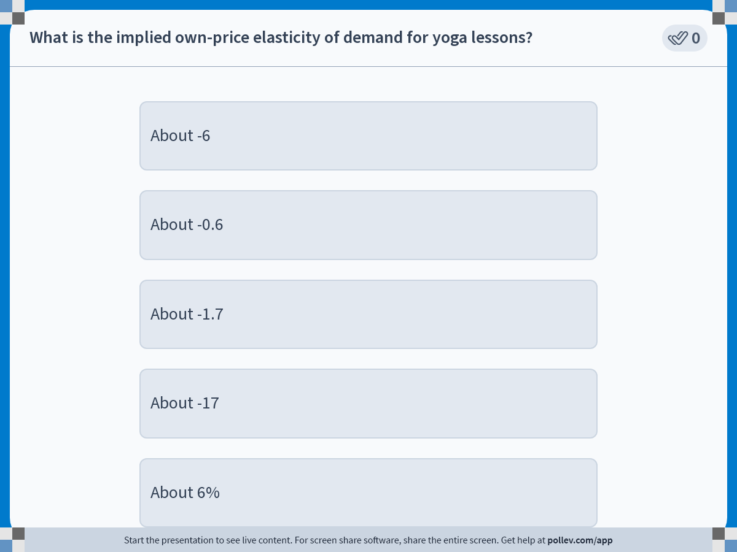
Demand Analysis · Elasticities
Poll: Elasticity for Yoga
Management 405 · Demand Analysis
11

Slide 31
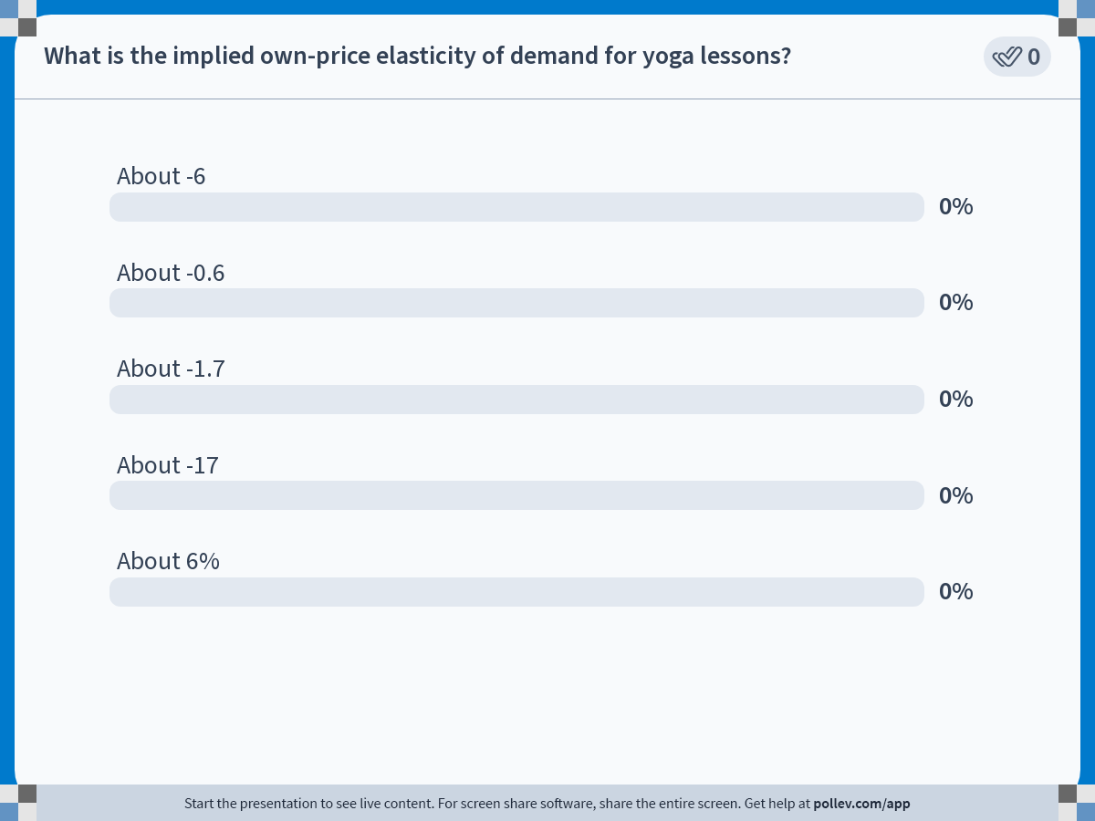
Demand Analysis · Elasticities
Poll Results
Management 405 · Demand Analysis
12

Slide 32
Demand Analysis · Own-Price Elasticity
Solution
+100%
E_{D}
=
=
−5.88 (≈ −6)
−17%
Unit free → not 6%
Is demand for yoga lessons elastic or inelastic?
Answer: elastic, since E_{D} < −1 (or |E_{D}| > 1)
As price falls, quantity rises by MORE than the price falls
Management 405 · Demand Analysis
13

Slide 33
Demand Analysis · Elasticities
Computing Elasticity — Method 1
When you have two price/quantity bundles (P₀, Q₀) and (P₁, Q₁)
This method approximates the percentage changes
Q₁ − Q₀
%ΔQ
Q₀
E_{D}
=
=
%ΔP
P₁ − P₀
P₀
Convention: start from the initial point (P₀, Q₀)
Problem Set 2 · #1, #3
Management 405 · Demand Analysis
14

Slide 34

Demand Analysis · Elasticities
Lottery Sales
In 2024 the MA State Lottery raised ticket prices from $2 to $5
As a result, weekly ticket sales fell from 142,170 to 100,297
What is the implied price elasticity of demand (using $2 as the initial price)?
Poll break
Management 405 · Demand Analysis
15

Slide 35
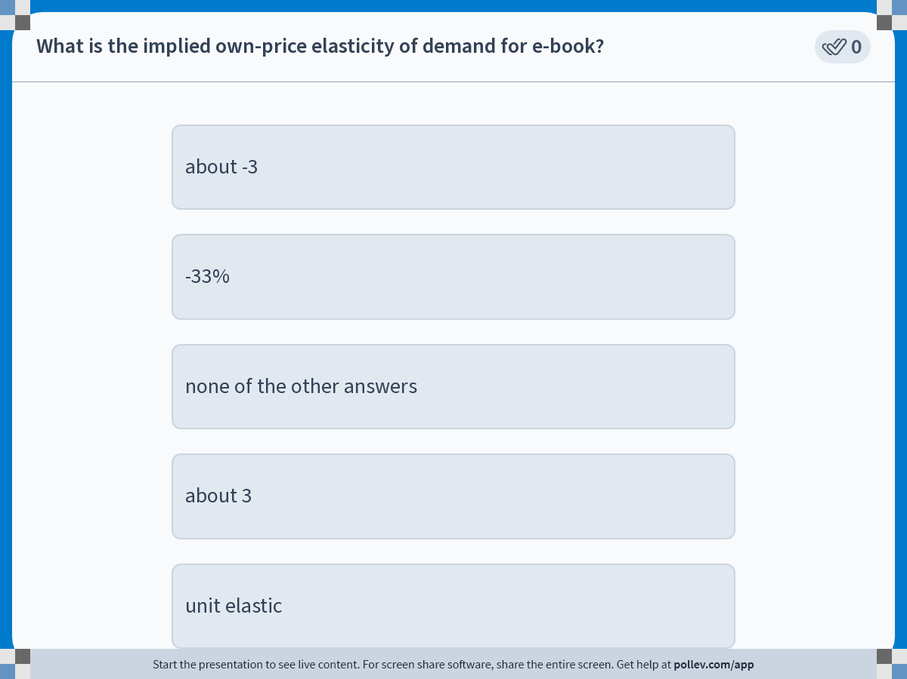
Demand Analysis · Elasticities
Poll: Implied Elasticity
Management 405 · Demand Analysis
16

Slide 36
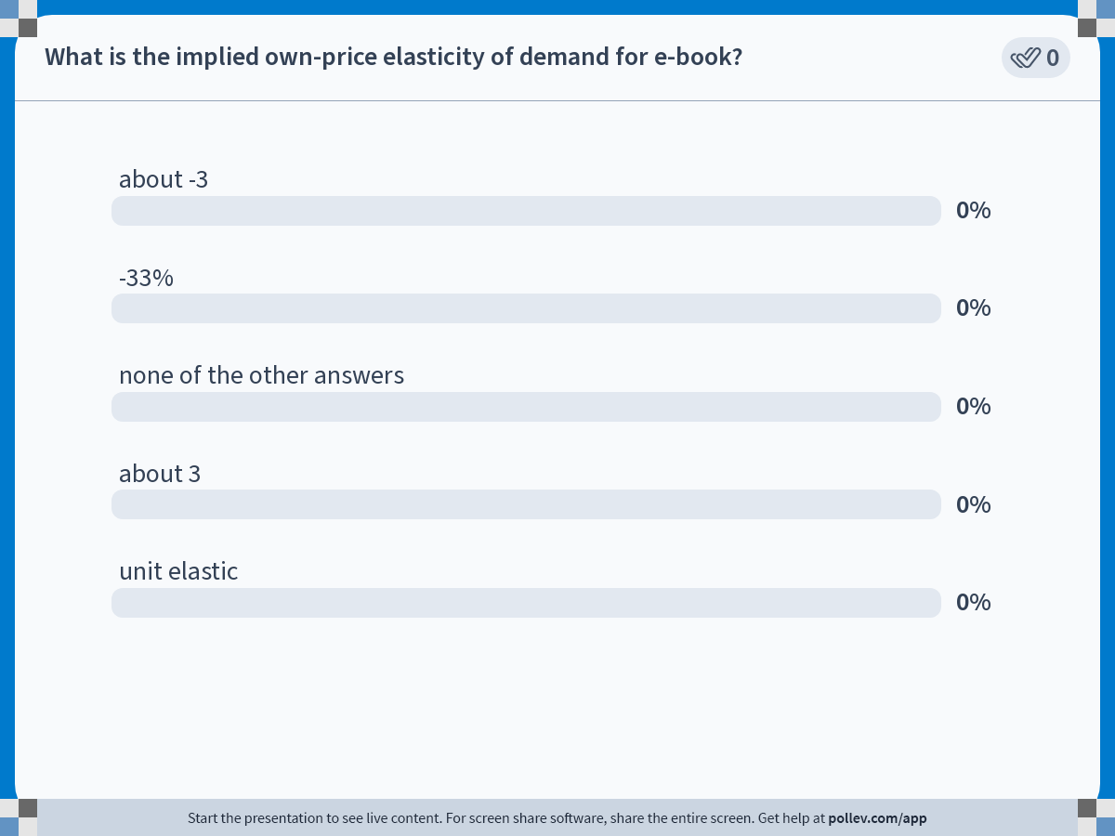
Demand Analysis · Elasticities
Poll Results
Management 405 · Demand Analysis
17

Slide 37
Demand Analysis · Elasticities
Solution
Price: P₀ = $2 → P₁ = $5
Quantity: Q₀ = 142,170 → Q₁ = 100,297
Q₁ − Q₀
100,297 − 142,170
%ΔQ
=
=
=
−29.5%
Q₀
142,170
P₁ − P₀
5 − 2
%ΔP
=
=
=
150%
P₀
2
%ΔQ
−29.5%
E_{D}
=
=
≈
−0.2
%ΔP
150%
Management 405 · Demand Analysis
18

Slide 38
Demand Analysis · Elasticities
Computing Elasticity — Method 2
When you have an entire demand curve, use it!
ΔQ
%ΔQ
Q
ΔQ
P
E_{D}
=
=
=
·
%ΔP
ΔP
ΔP
Q
P
Slope of demand
(constant)
Suppose the demand curve is: Q = 1,600 − 4P (slope = −4)
For a linear demand curve, elasticity depends on the price at which it is measured
Problem Set 2 · #5
Management 405 · Demand Analysis
19

Slide 39
Demand Analysis · Elasticities
Elasticity Along a Linear Demand Curve
%ΔQ
ΔQ
P
E_{D}
=
=
·
%ΔP
ΔP
Q
Price
E_{D} = −∞
E_{D} < −1 elastic
E_{D} = −1 unit elastic
−1 < E_{D} < 0 inelastic
D
E_{D} = 0
Quantity
Management 405 · Demand Analysis
20

Slide 40
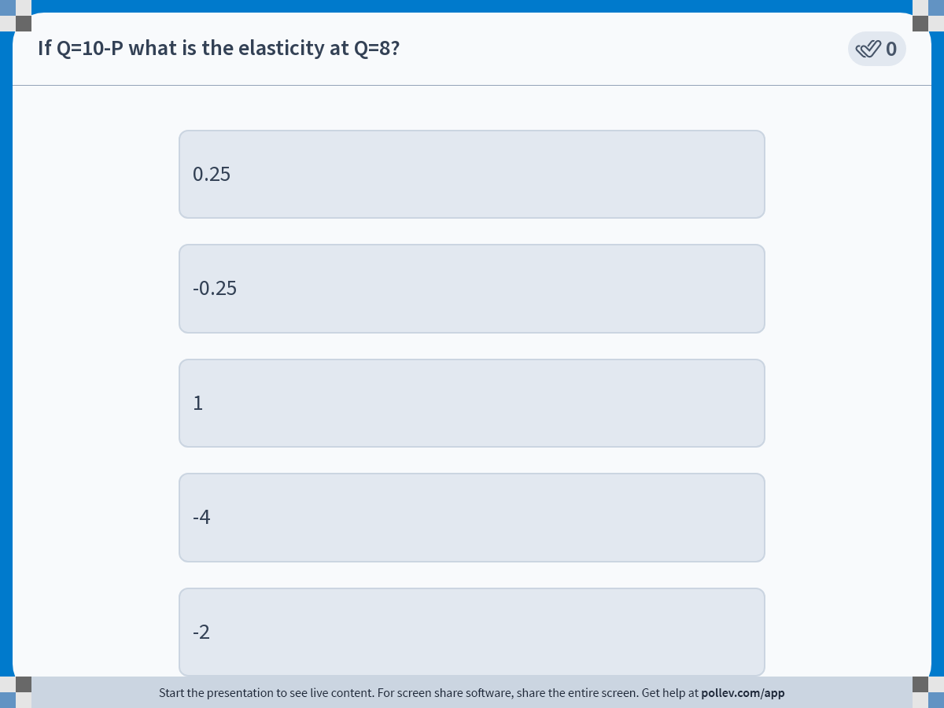
Demand Analysis · Elasticities
Poll: Elasticity at Q = 8
Management 405 · Demand Analysis
21

Slide 41
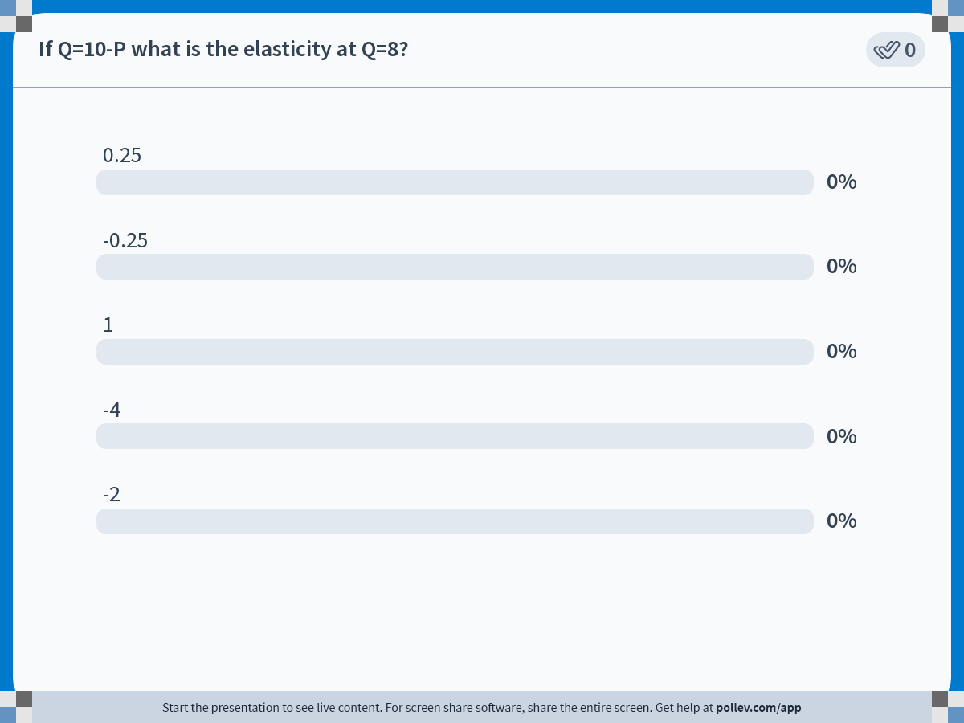
Demand Analysis · Elasticities
Poll Results
Management 405 · Demand Analysis
22

Slide 42
Demand Analysis · Elasticities
If Q = 10 − P, What Is Elasticity at Q = 8?
ΔQ
P
2
−1
E_{D}
=
·
=
−1 ·
=
ΔP
Q
8
4
Slope of demand: ΔQ/ΔP = −1
At Q = 8, price P = 10 − 8 = 2
E_{D} = −0.25 → demand is inelastic
Management 405 · Demand Analysis
23

Slide 43
Demand Analysis · Elasticities
Special Cases of Price Elasticity
Price
Price
D
E_{D} = −∞
E_{D} = 0
Perfectly elastic
Perfectly inelastic
D
Quantity
Quantity
Elasticity depends on the starting price — except in these two extremes
Management 405 · Demand Analysis
24

Slide 44
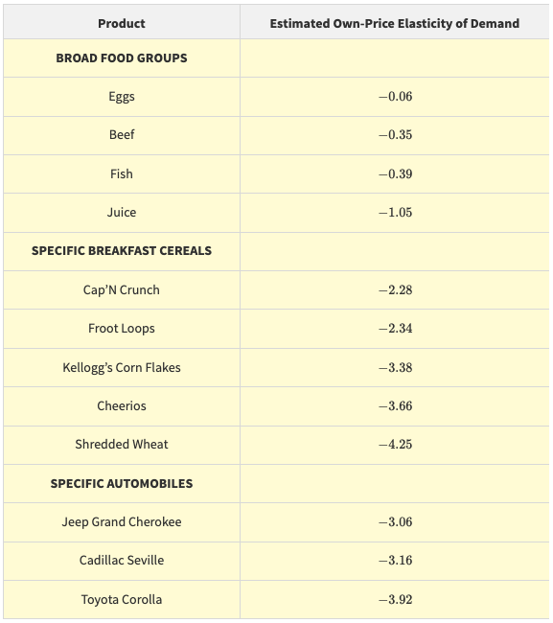
Demand Analysis · Elasticities
What Determines the Elasticity of Demand?
Availability of substitutes
How many
How close
Willingness to switch
Firm size relative to the market
Smaller size → higher demand elasticity
Management 405 · Demand Analysis
25

Slide 45
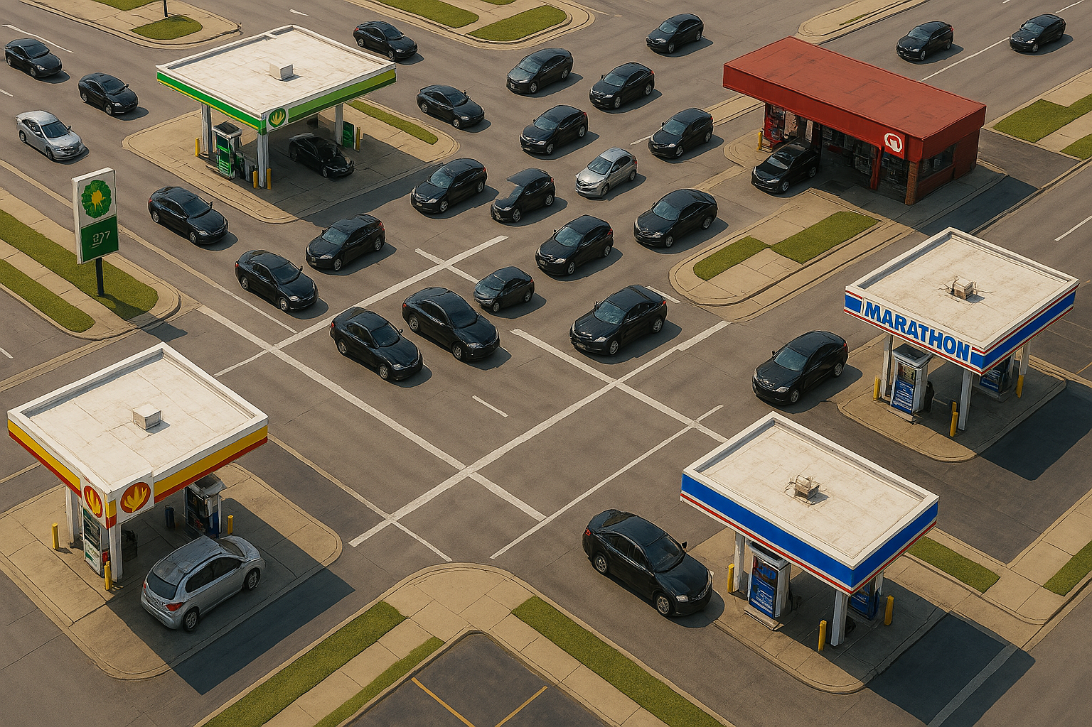
Demand Analysis · Elasticities
Market vs. Firm Elasticity
The elasticity a company faces is not the same as the elasticity the industry faces
A firm's demand is more elastic when…
the overall market elasticity is high
the firm's market share is small
competitors don't react to its price changes
Gas market vs. Gas stations
Management 405 · Demand Analysis
26

Slide 46
Demand Analysis · Elasticities
Three Types of Elasticity
Own-price elasticity
Income elasticity
Cross-price elasticity
%ΔQ
%ΔQ
%ΔQ_{X}
E_{D}
=
E_{I}
=
E_{X,Y}
=
%ΔP
%ΔI
%ΔP_{Y}
Management 405 · Demand Analysis
27

Slide 47



Demand Analysis · Income Elasticity
Income Elasticity
%ΔQ
E_{I}
=
%ΔI
% change in quantity demanded divided by % change in income
Intuition: how sensitive demand is to customers' income
If > 0 → normal good (if > 1 → luxury good)
If < 0 → inferior good
Management 405 · Demand Analysis
28

Slide 48
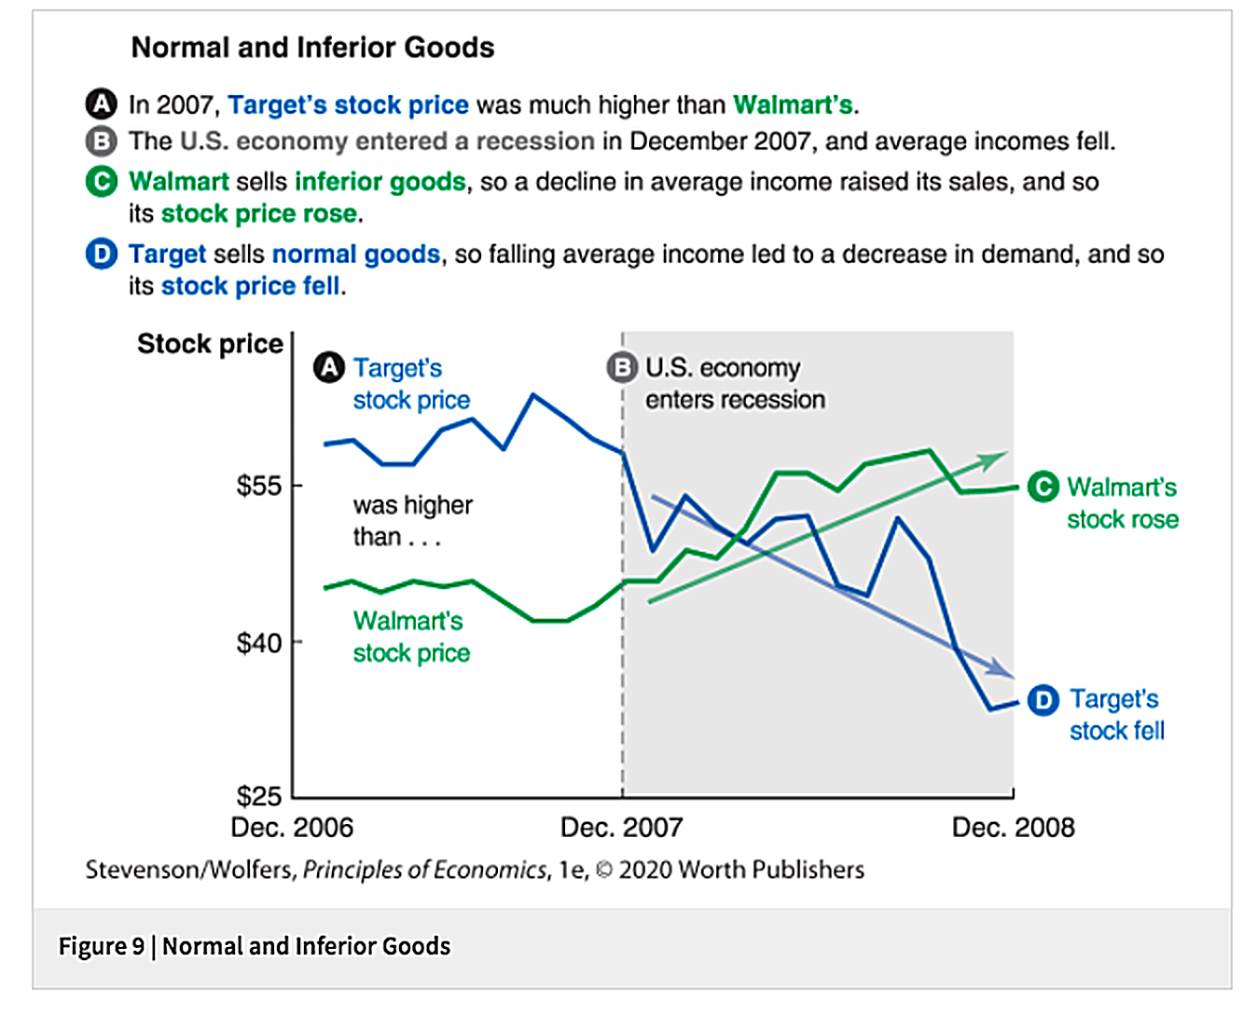
Demand Analysis · Income Elasticity
Which Retailers Do Well in a Recession?
Management 405 · Demand Analysis
29

Slide 49
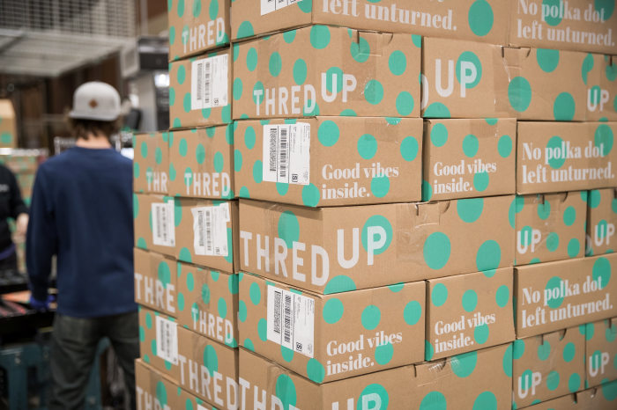

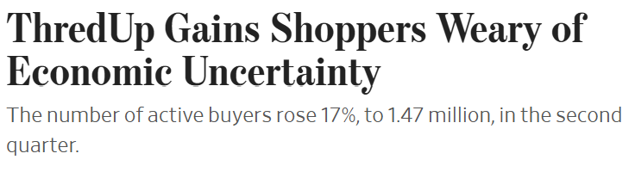
Demand Analysis · Income Elasticity
Inferior Goods in the News
Management 405 · Demand Analysis
30

Slide 50
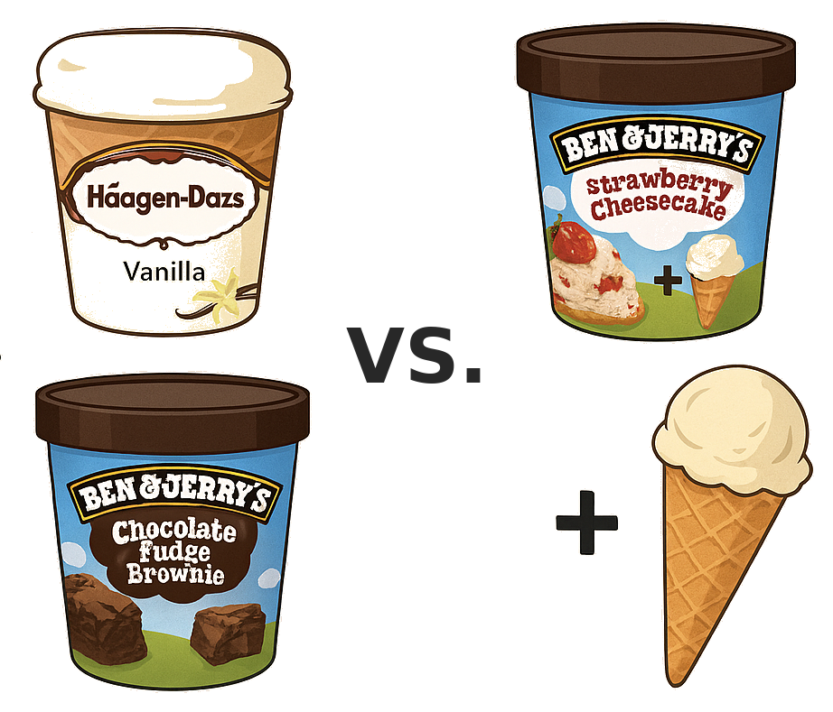
Demand Analysis · Cross-Price Elasticity
Cross-Price Elasticity
%ΔQ_{X}
E_{X,Y}
=
%ΔP_{Y}
% change in the quantity demanded of good X, divided by the % change in the price of good Y
Intuition: How sensitive demand is to changes in the price of another good
Two cases:
If > 0, then the goods are substitutes
If < 0, then the goods are complements
Management 405 · Demand Analysis
31

Slide 51

Demand Analysis · Cross-Price Elasticity
Example: Movie Tickets and Popcorn
A theater raises its ticket price from $10 to $12
Quantity of popcorn demanded falls by 8%
What is the implied cross-price elasticity?
Poll break
Management 405 · Demand Analysis
32

Slide 52
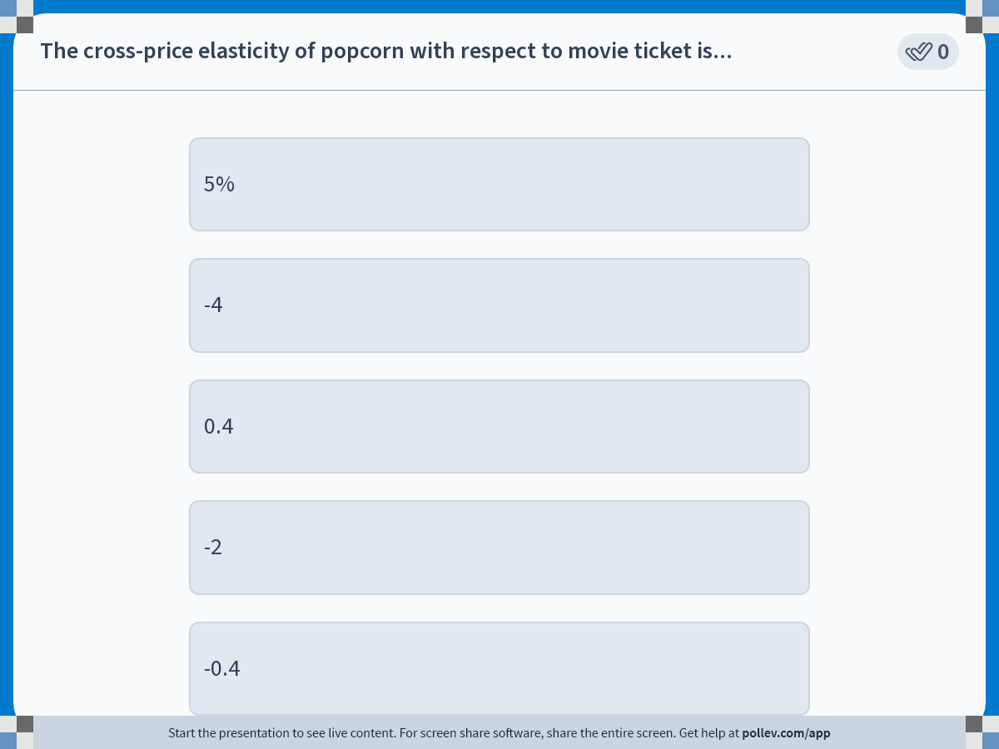
Demand Analysis · Elasticities
Poll: Cross-Price Elasticity
Management 405 · Demand Analysis
33

Slide 53
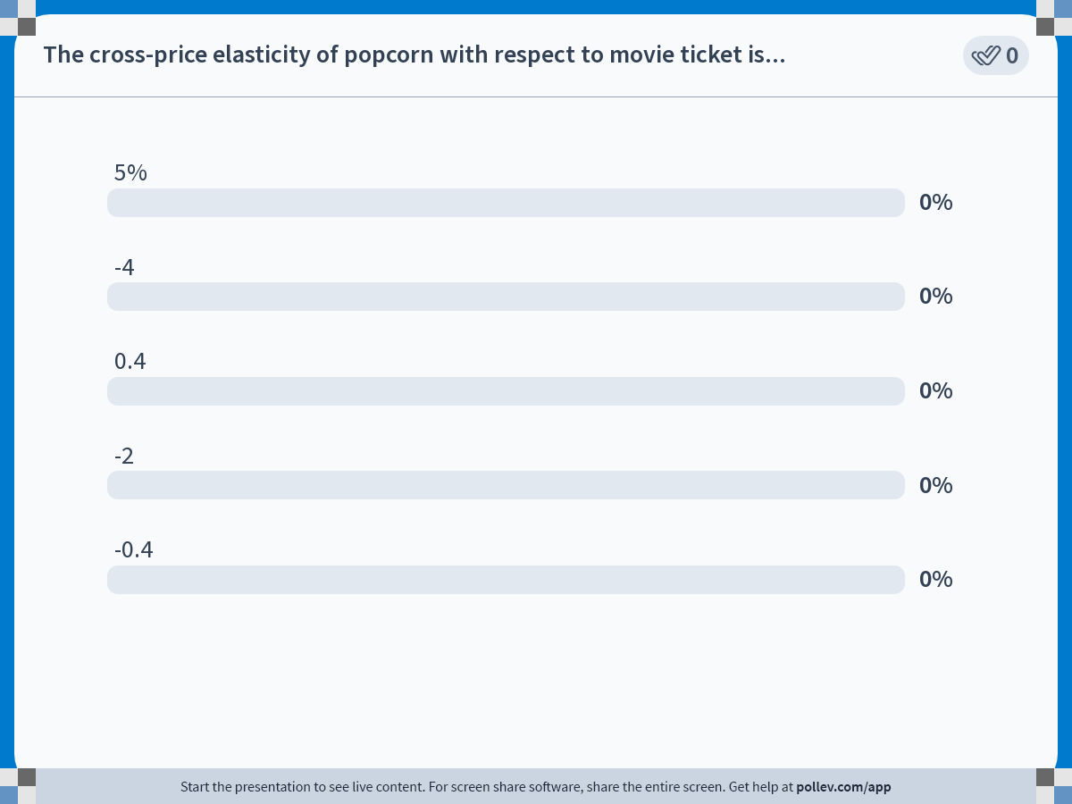
Demand Analysis · Elasticities
Poll Results
Management 405 · Demand Analysis
34

Slide 54
Demand Analysis · Elasticities
Solution
−8%
E_{X,Y}
=
=
−0.4
+20%
Change in quantity of popcorn (X) = −8%
Change in ticket price (Y) = (12−10)/10 = +20%
E_{X,Y} = −0.4 → popcorn and tickets are complements
Management 405 · Demand Analysis
35

Slide 55
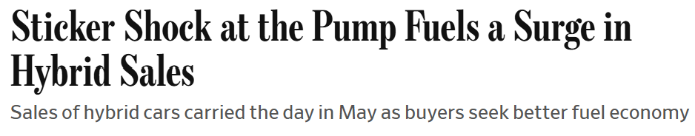

Demand Analysis · Elasticities
Cross-Price Elasticity in the News
Management 405 · Demand Analysis
36

Slide 56
Demand Analysis · Elasticity and Revenue
Cheat Sheet: Own-Price Elasticity
Definition
Categories
%ΔQ
E_{D}
=
Inelastic: −1 < E_{D} < 0 (|E_{D}| < 1)
Unit-elastic: E_{D} = −1
Elastic: E_{D} < −1 (|E_{D}| > 1)
%ΔP
Intuitively: measures consumers' price sensitivity
Computing elasticity
Two observed points (approximation):
Whole demand function known:
ΔQ
P
(Q₁−Q₀)/Q₀
E_{d}
=
·
E_{d}
=
ΔP
Q
(P₁−P₀)/P₀
ΔQ/ΔP = slope of the demand function (Q as a function of P)
Management 405 · Demand Analysis
33

